Slide 1
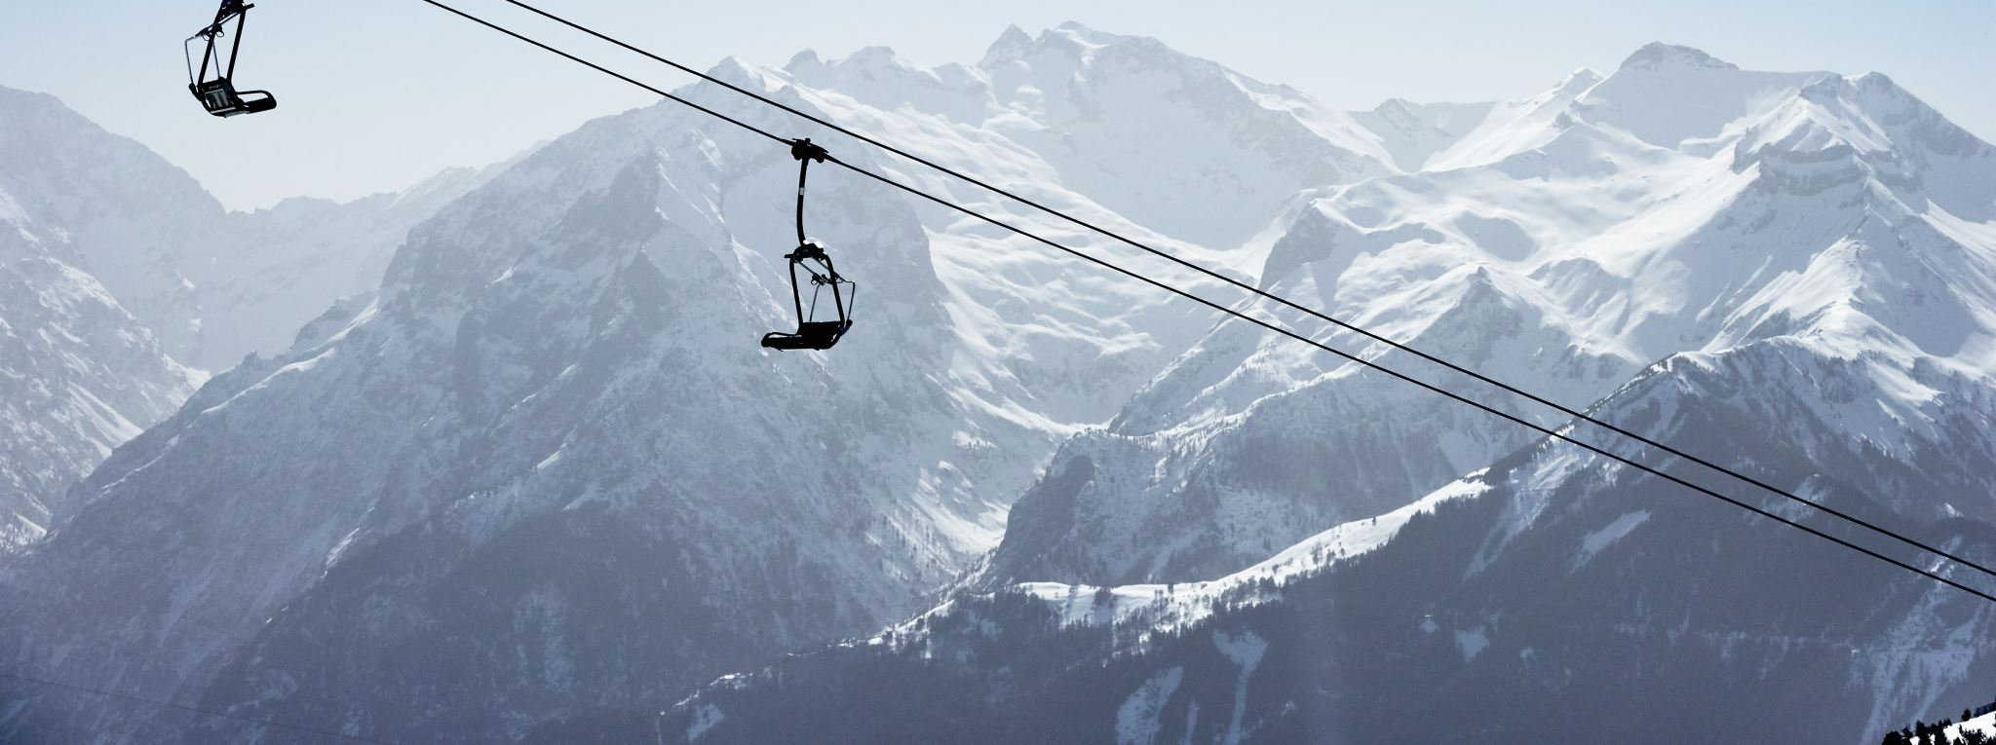
Big Mountain Ski Resort
Modeling to Reduce Operating Costs and Increase Revenue
June 2025

Slide 2
Problem
An added chairlift increased operating costs by $1.54M.
Current pricing strategies do not support revenues to outpace the increased operating costs.
Ticket prices do not capitalize on the resort’s most-valued features.

Slide 3
Recommendation:
Focus on valued resort features: Add a ski run with chair lift to increase the highest vertical drop.
Increase Adult Weekend ticket prices from $81.00 to $83.00.
Key Findings
Market value currently shows Big Mountain Resort at the top of the ticket pricing
Increasing ticket prices could be supported based on valued features
The resort features with most value are Runs with the greatest vertical drop, snow-making capabilities, number of runs, and fast delivery (fast quads)
Modeled results and current pricing are similar. Modeled results produce revenues of ~3.47M over a season

Slide 4
Modeling Best performance for Big Mountain: Random Forest Regressor Lowest Error Rate Least variability in results Consistency in cross-validation
Models built and compared:
Baseline assessment
using the mean as a predictor
resultant predictions of ticket price: +- $19
Linear Regression
assumes a linear relationship between features and ticket price
resultant predictions of price: +- $11
Random Forest Regressor
no assumptions about data structure; captures complex, non-linear relationships.
resultant predictions of ticket price: +- $9.5

Slide 5
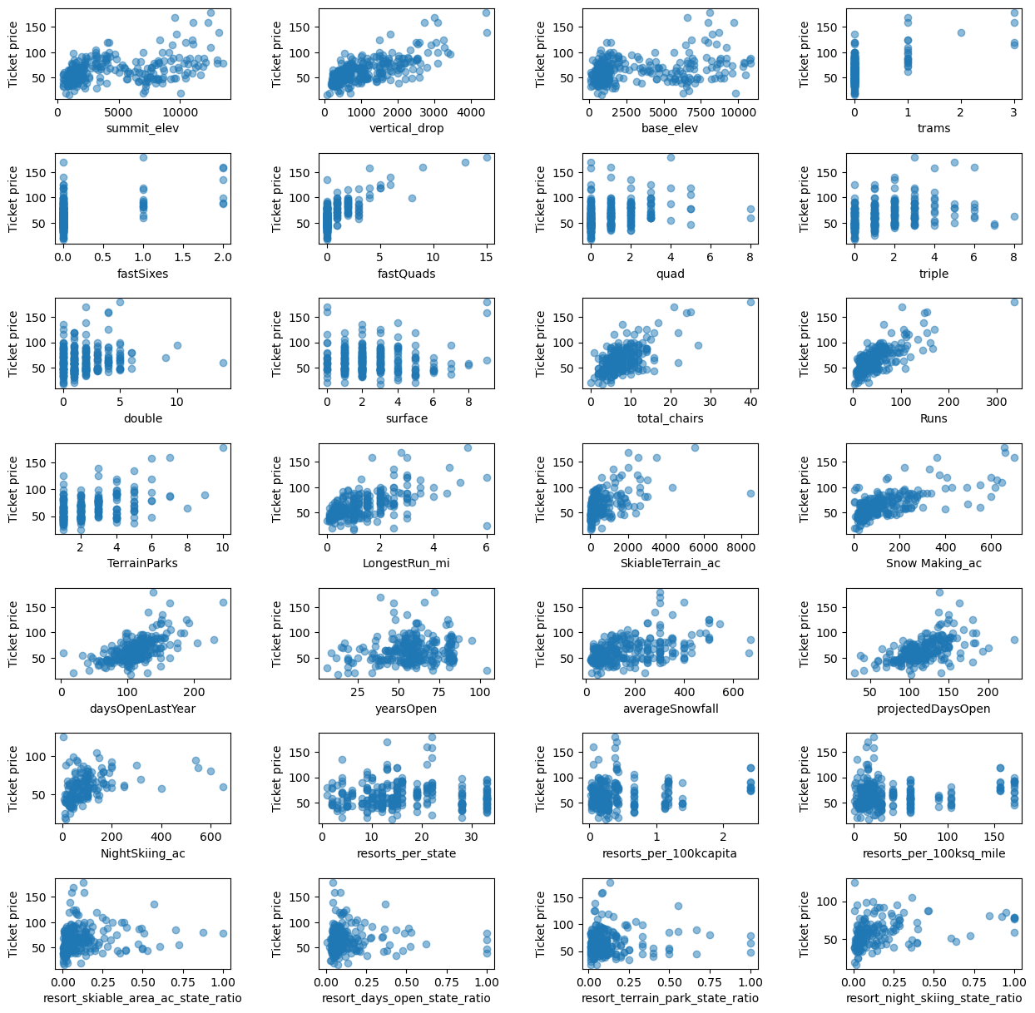
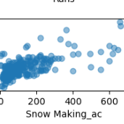
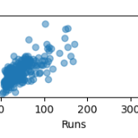
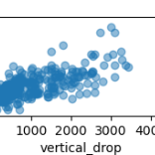
Feature Comparisons

Slide 6
Modeling Results
350,000 Visitors/5 Days
Scenario 1: Close up to 10 runs
Result: No real difference closing 1-5 runs; closing 6 or more results in a large drop in revenue
Scenario 2: Increase vertical drop by adding a run and installing an additional lift
Result: Supports ticket price by$1.99 with expected full season earning of ~ $3.47M
Scenario 3: Same as scenario 2 but adding 2 acres of snow-making coverage
Result: No discernible difference from Scenario 2.
Scenario 4: Increase the longest run with additional snow-making.
Result: No difference.

Slide 7
Analysis
Current Adult Weekend ticket prices are $81.00. Modeling of data indicates that prices could be increased up to $95.87 with an error of about $11.00.
Factoring modeling variances with current ticket price, increased pricing is supportable.
Modeling for best feature to increase revenues against resulted in four dominant features which are the vertical drop, snow making, # of runs, fast quads
Modeling ticket prices against features predicted with a high confidence that an increase of ticket prices to $83,00 would be supported and produce revenues of ~$3.47M seasonally.

Slide 8
Conclusion
- The model presented here predicts an increase in revenue by increasing ticket pricing.
The feature that most enables this is increasing a run with vertical drop and chair lift to access it
This model can be used by Big Mountain Ski Resort business analysts to further predict different scenarios for either increased revenue or reducing operating costs.

